Slide 1
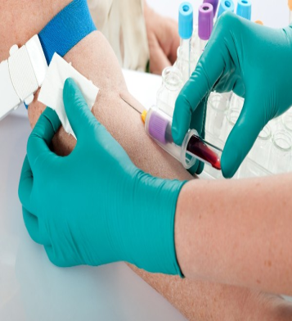
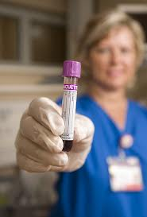
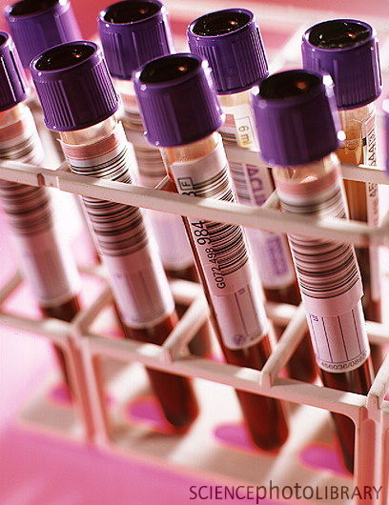
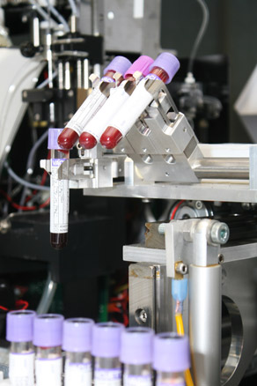
EMR eOrders - Pathology
Labelling Requirements
Press F5 to commence the Screen Show then push this button to continue

Slide 2
EH Pathology receive hundreds of samples every day, and partial or incorrect labelling of samples and/or request forms are the most common reason for being unable to process samples. As many as 1 in 2000 samples do not even belong to the patient whose name appears on the tube (and that is only the ones that are detected!)⁽¹⁾ (1) Gonzalez-Porras, J. R., I. F. Graciani, et al. (2008). “Tubes for pretransfusion testing should be collected by blood bank staff and hand labelled until the implementation of new technology for improved sample labelling. Results of a prospective study.” Vox Sanguinis 95(1): 52-56.
Did you know…

Slide 3
As part of the eOrders upgrade:
EMR Specimen Labels will now be scanned by EH Pathology’s analysers….

Slide 4
Remember the Four ‘C’s when collecting specimens via the EMR:
C - Correct EMR Label on ALL Specimens
C - Correct Tube Type
C - Correct Label Alignment
C - CHART CHART CHART!

Slide 5
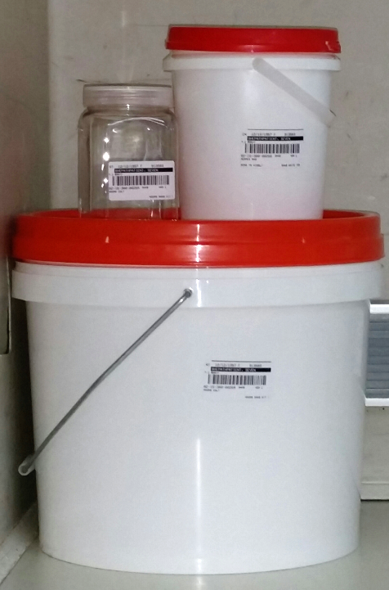
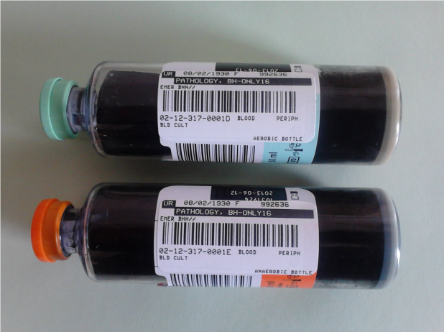
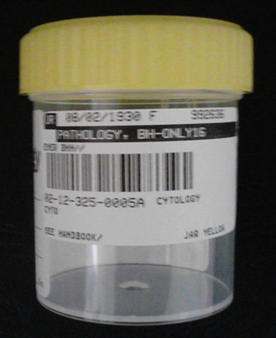
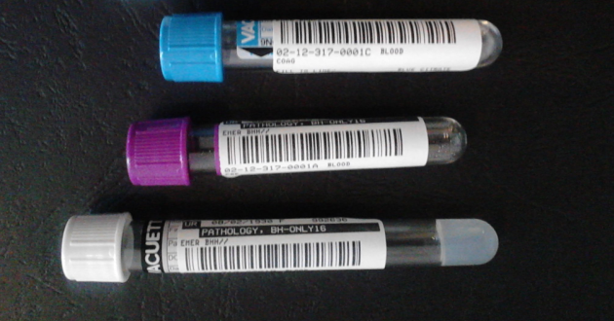
Correct EMR Label on ALL Specimens:

Slide 6
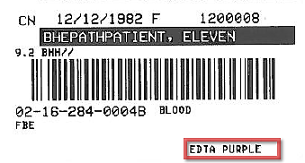
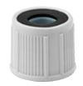
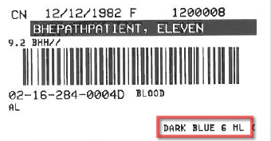
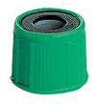
Correct Tube Type
✓
✗

Slide 7
Correct Label Alignment
Our analysers read
barcodes like this:
Therefore place all labels like this…

Slide 8
and not like this……..
but like this…
Sideways
Barber’s Pole
Scrunchie
Over the top

Slide 9
and like this……..

Slide 10
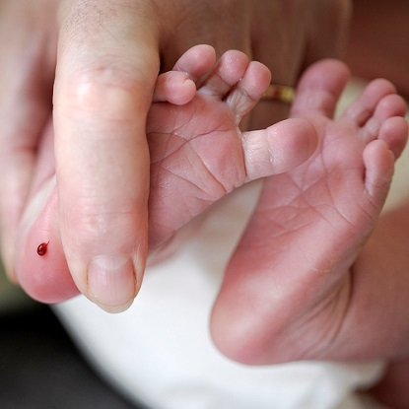
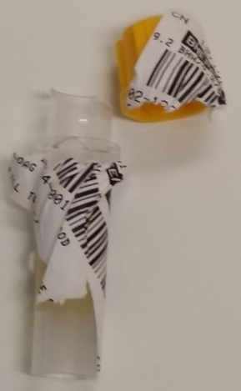
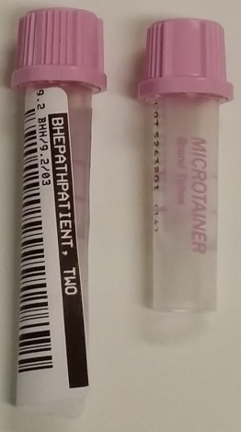
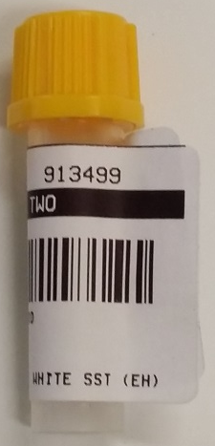
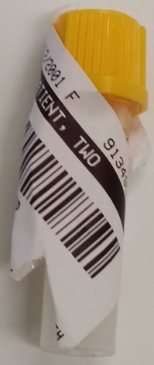
If you need to use Capillary collection tubes, place the EMR labels so that
all information can be seen, and
the label won’t get damaged during laboratory testing
We may not be able to use the barcodes, but most importantly we will know who the sample comes from and will be able to do testing
Covered all over
Until we take the lid off...
A sticky tail..
Until we have to put
it into a centrifuge...
Perfect

Slide 11
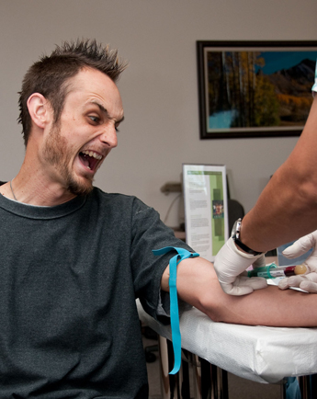
!
REMEMBER
Specimens must be CHARTED
CHART and COLLECTION TIME IN EMR MUST MATCH
Otherwise …..
A RE-COLLECTION WILL BE REQUIRED!

Slide 12
Is this for ALL samples?
YES!!
This means:
Zero Tolerance for Blood Bank related tests – NOTE THAT ALL SAMPLES FOR BLOOD BANK REQUESTS MUST BE ACCOMPANIED BY A SIGNED PAPER REQUEST FROM
‘PRECIOUS ’ samples such as biopsies and CSF will be processed - but ONLY AFTER THE ATTENDING PHYSICIAN HAS COMPLETED A WRITTEN STATEMENT REGARDING THE IDENTIFICATION OF THE SAMPLE.
ALL OTHER SAMPLES WILL NEED TO BE RE-COLLECTED
NO emr LABELS = NO TESTS !

Slide 13
More information? Look for the EMR icon on the Intranet…

